Slide 1
Cell Membranes
Links, Lesson, & Activity – People Model
Develop and use a model to describe the function of a cell as a whole and ways parts of cells contribute to the function. [Clarification Statement: Emphasis is on the cell functioning as a whole system and the primary role of identified parts of the cell, specifically the nucleus, chloroplasts, mitochondria, cell membrane, and cell wall.] [Assessment Boundary: Assessment of organelle structure/function relationships is limited to the cell wall and cell membrane. Assessment of the function of the other organelles is limited to their relationship to the whole cell. Assessment does not include the biochemical function of cells or cell parts.]
Students use the model to describe* a causal account for the phenomenon, including how different parts of a cell contribute to how the cell functions as a whole, both separately and together with other structures. Students include how components, separately and together, contribute to:
ii. Maintaining the structure of the cell and controlling what enters and leaves the cell.

Slide 2
Useful links
Cell Membrane Pearson Animation
https://www.youtube.com/watch?v=I1MZG6508IM
Español
https://www.youtube.com/watch?time_continue=3&v=Dswbr6kELVM
http://www.phschool.com/science/biology_place/biocoach/biomembrane1/structure.html
https://www.youtube.com/watch?v=Qqsf_UJcfBc
Fluid Mosaic Membrane
Membrane Rap
https://www.youtube.com/watch?v=Pfu1DE9PK2w
Cell Membranes the easy way
https://www.youtube.com/watch?v=QQgXfuFyKM4

Slide 3
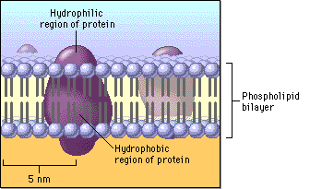
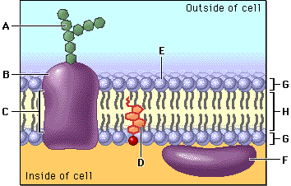
Cell Membrane is like a gel fluid
A double layer of fat molecules with protein machines.
The surfaces of cell membranes are like an oil bubble or wall that keep water inside and out separated. Like oil on water, the membrane can move.
(Fats)
Hydrophilic molecules tend to interact with water and with each other. Hydrophobic molecules avoid interaction with water and tend to interact with other hydrophobic molecules.

Slide 4
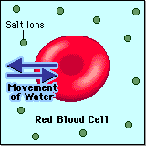
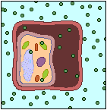
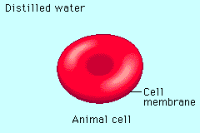
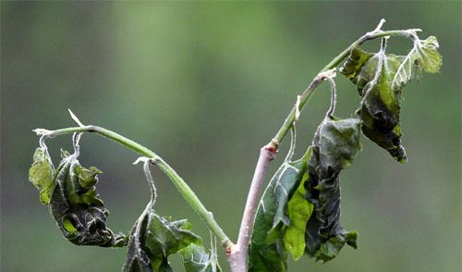
Osmosis: Movement of Water Across Membranes
Water can move in or out to balance the inside and outside. Salt and other substances can pull water through.
The presence or absence of cell walls helps cells respond to changes in their environment.
Cell
Wall
In plants, when cells lose too much water, they can shrink away from the cell wall and wilt
Cell
Membrane

Slide 5
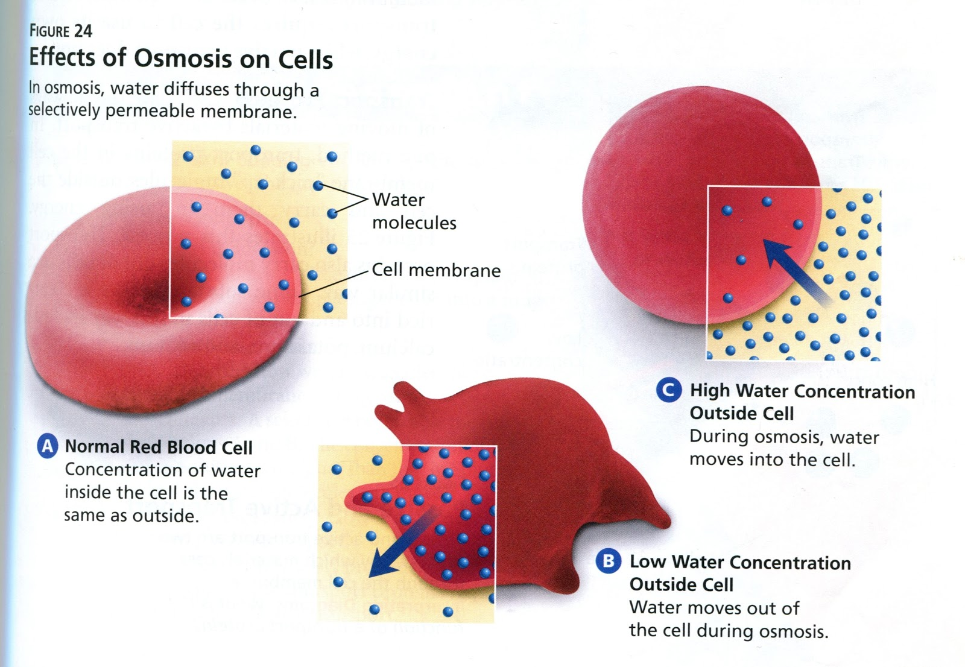
Osmosis: Movement of Water Across Membranes

Slide 6
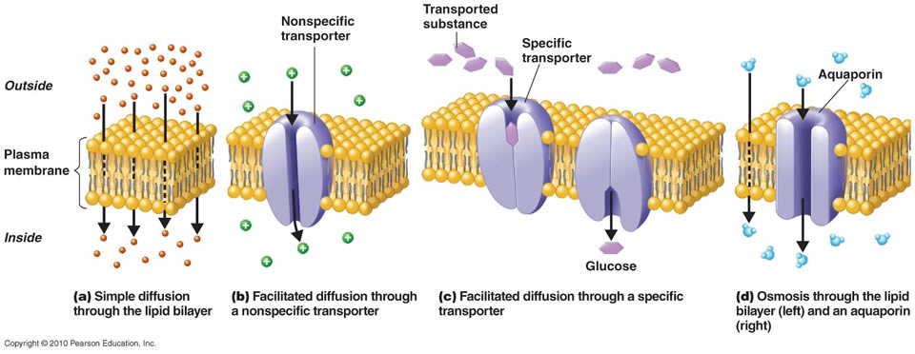
Osmosis: Movement of Water Across Membranes
shaped molecules use a spring-like protein to pop through
Tiny molecules bleed through the membrane
larger molecules like ions use a tunnel protein
Water uses a specific protein to get through

Slide 7
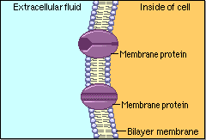
Gates Control what Enters and Leaves
Cell membranes are selective.
  Some things cross the membrane freely,
  some cross with assistance, and
  others do not cross at all.
Protein machines in the membrane can act like tunnels only letting small molecules of the right size or shape in.
Other proteins grab and help things across if they have the right ‘key’.
Big molecules need other ways in.

Slide 8
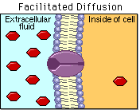
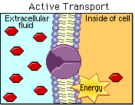
Passive and Active Transport
Most big molecules need help.
Proteins grab shapes on the molecule.
Passive transport does not use energy to move a molecule through a protein.
Active transport uses ATP energy to move a molecule through a protein.

Slide 9
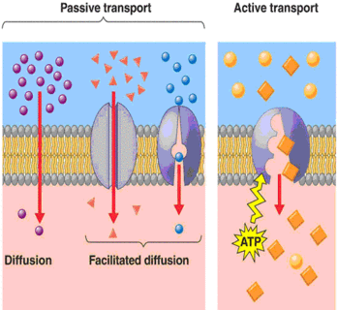
Passive and Active Transport

Slide 10
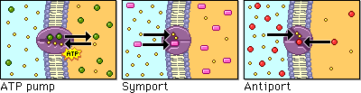
Types of Active Transport
Active transport can occur as a direct result of ATP hydrolysis (ATP pump) or by coupling the movement of one substance with that of another (symport or antiport).
ATP pumps use energy to force the molecule through.
Sym and Anti Ports use second molecule to help the machine work, passing both in the same or opposite directions.

Slide 11
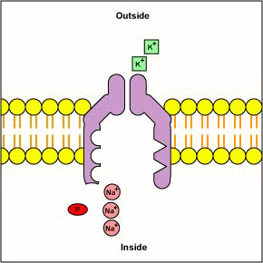
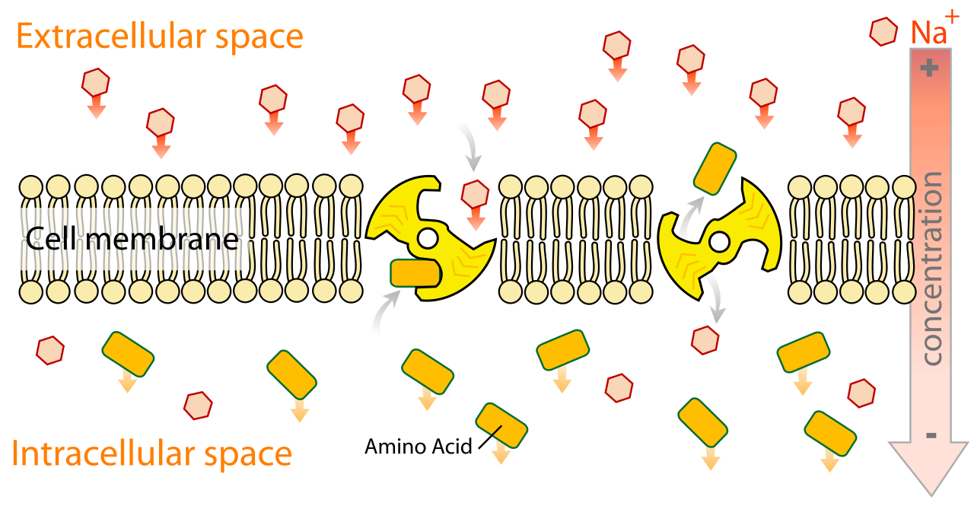
Types of Active Transport
Potassium salt
Sym and Anti Ports often use salts (electrolytes) like sodium and potassium second molecule to help the machine work.
Sodium salt

Slide 12
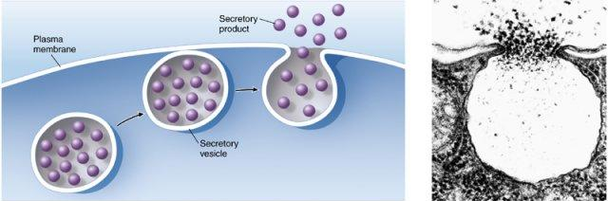
Exocytosis- Vacuoles dump through membrane
Vacuoles (and vesicles) are little membrane bubbles that store and move molecules.
Vacuoles can melt into the membrane and dump stuff out.

Slide 13
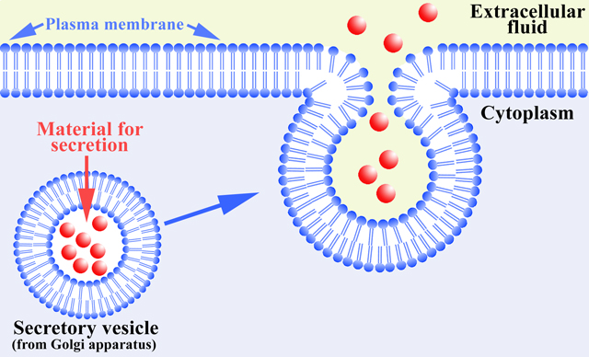
Exocytosis- Vacuoles dump through membrane
Vacuole membranes become part of the cell membrane.

Slide 14
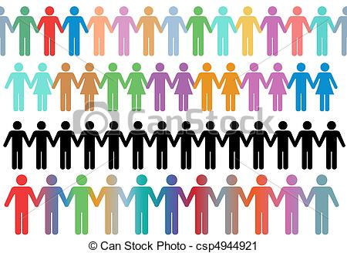
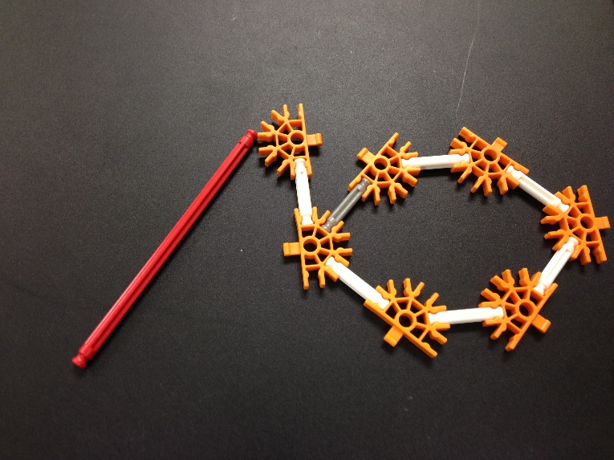
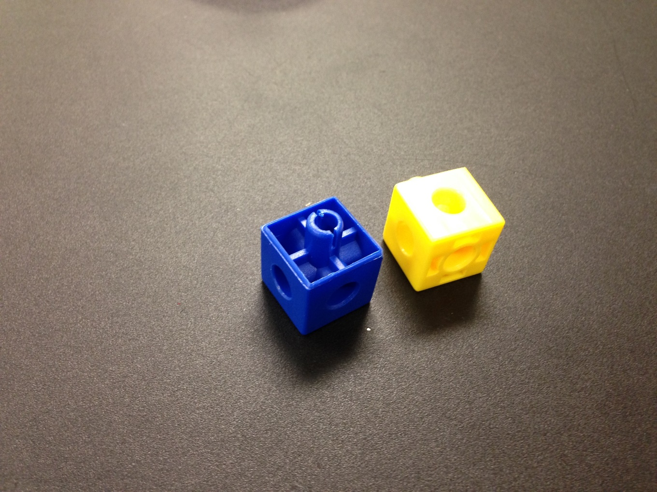
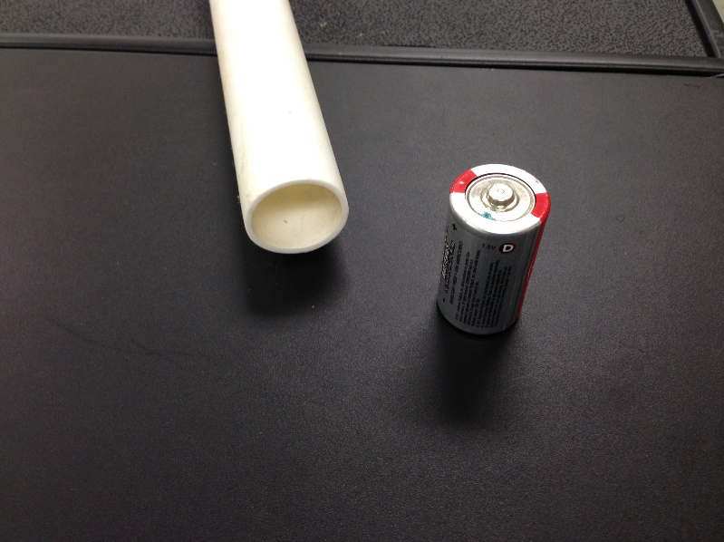
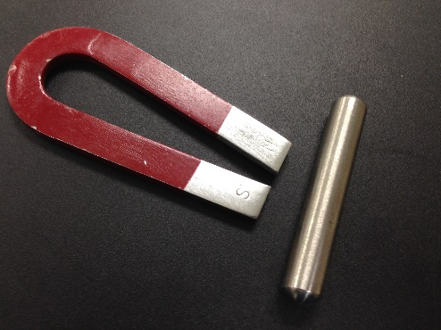
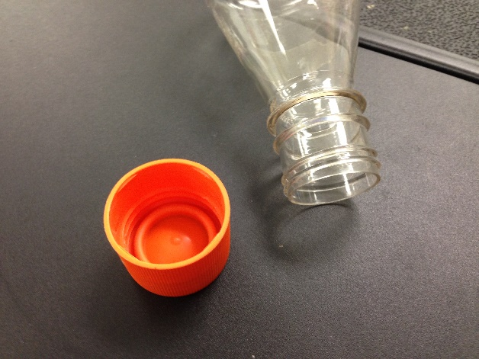

Activity: Human Membrane
Form a line or circle of people every other person will be a protein.
Proteins will hold the k’nex rod, a cube, tube, magnet, and cap.
Inside the circle or other side of line, Someone holds a bag ( the vacuole).

Slide 15
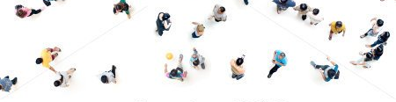
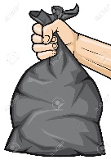
Activity: Human Membrane
Outside line or circle are people holding a
k’nex ring, a cube, battery, iron, and bottle.
Molecules
Cell Membrane
Vacuole

Slide 16
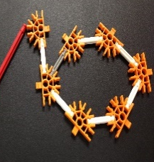
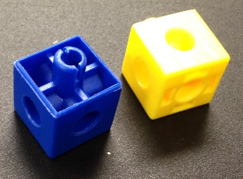
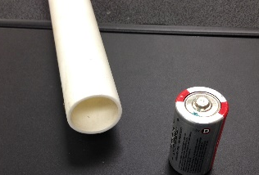



Activity: Human Membrane
The molecule people outside will move around and try to fit the protein keys.
If the molecule fits, the protein person will use the key to grab and move the molecule to the vacuole inside.
Molecules
Cell Membrane
Vacuole

Slide 17
Activity: Human Membrane
Molecules
Cell Membrane
When the vacuole has garbage or something to go out, it moves to the membrane and dumps it outside
Vacuole

Slide 18
Cell Membranes Worksheet
Name ___________ Period __ Date ___
Draw a membrane with fat molecules and proteins
Draw a wilting plant cell with water going out of the membrane.
Draw a protein grabbing a molecule
Describe how a membrane works to let things in and out.
List at least three analogies that you could use to describe how membranes work.
What other things control what goes in or out?
What other things have keys or passes or passwords?
What other things grab things and pull them through?

